Slide 1
创新研究课程 科研项目短课

Slide 2
Course Syllabus 课程大纲
Content 内容 | 课时 | 课程说明 | 课后练习 | 备注
Version control – Git & Github, learn to write ReadMe | 3 |  | Write a readme file and upload to Github | README: https://classroom.udacity.com/courses/ud777 Git: https://classroom.udacity.com/courses/ud123 Github: https://classroom.udacity.com/courses/ud456 https://classroom.udacity.com/courses/ud775
Latex for scientific writing | 3 |  | Download CVPR latex template and upload to Github | The Not So Short Introduction to Latex (PDF)
Python tutorial | 3 |  | Finish a demo script and upload to Github | http://cs231n.github.io/python-numpy-tutorial/
Computer Vision and Opencv | 3 |  | Finish a demo script and upload to Github | http://cs231n.stanford.edu/ https://docs.opencv.org/3.4/d9/df8/tutorial_root.html https://www.pyimagesearch.com/2014/11/17/non-maximum-suppression-object-detection-python https://www.pyimagesearch.com/2015/02/16/faster-non-maximum-suppression-python/
Visual Tracking | 3 |  | Finish a demo script and upload to Github
Introduction to deep learning | 3 |  | -- | https://www.coursera.org/learn/ai-for-everyone/

Slide 3
Today’s agenda:
Brief discussion of Viola Jones face detector
Visual Tracking

Slide 4
Viola–Jones object detection framework
https://en.wikipedia.org/wiki/Viola–Jones_object_detection_framework

Slide 5
The algorithm has four stages:
Haar Feature Selection
Creating an Integral Image
Adaboost Training
Cascading Classifiers

Slide 6
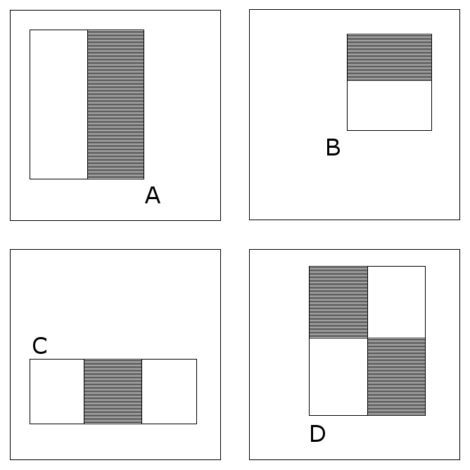



Haar Feature Selection
Notes:
All human faces share some similar properties. These regularities may be matched using Haar Features.
A few properties common to human faces:
The eye region is darker than the upper-cheeks.
The nose bridge region is brighter than the eyes.

Slide 7
Quiz: how many Haar features?
2 two-rectangle features, 2 three-rectangle features and 1 four-rectangle feature. not explicitly the color or luminance.
We cannot define feature type A as a 1x1 pixel block; it must at least be at least 1x2 pixels. Also, type D must be at least 2x2 pixels, and this rule holds accordingly to the other features.
We cannot define feature type A as a 1x3 pixel block as the middle pixel cannot be partitioned, and subtracting it from itself is identical to a 1x2 pixel block; this feature type is only defined for even widths. Also, the width of feature type C must be divisible by 3, and this rule holds accordingly to the other features.
We cannot define a feature with a width and/or height of 0. Therefore, we iterate x and y to 24 minus the size of the feature.
Notes:
There are only 2 two-rectangle features, 2 three-rectangle features and 1 four-rectangle feature. The logic behind this is that we are observing the difference between the highlighted rectangles, not explicitly the color or luminance or anything of that sort.
We cannot define feature type A as a 1x1 pixel block; it must at least be at least 1x2 pixels. Also, type D must be at least 2x2 pixels, and this rule holds accordingly to the other features.
We cannot define feature type A as a 1x3 pixel block as the middle pixel cannot be partitioned, and subtracting it from itself is identical to a 1x2 pixel block; this feature type is only defined for even widths. Also, the width of feature type C must be divisible by 3, and this rule holds accordingly to the other features.
We cannot define a feature with a width and/or height of 0. Therefore, we iterate x and y to 24 minus the size of the feature.

Slide 8
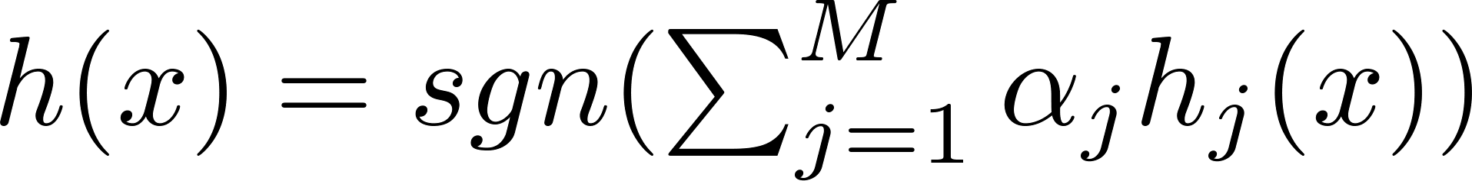
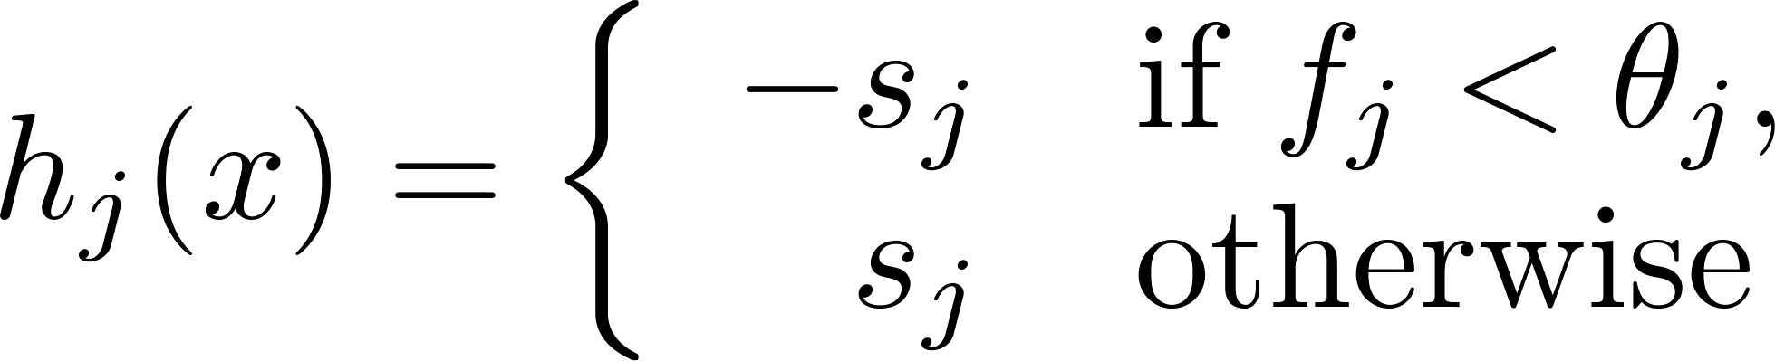
Learning algorithm: AdaBoost

Slide 9
视觉跟踪 Visual tracking

Slide 10
What is “Visual Tracking”?
Visual tracking is the task of predicting the trajectory of a target in a video.

Slide 11
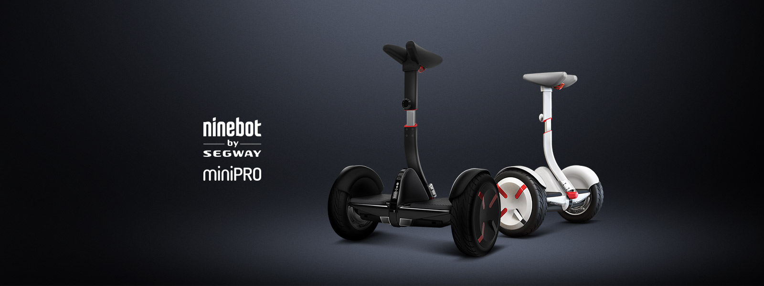

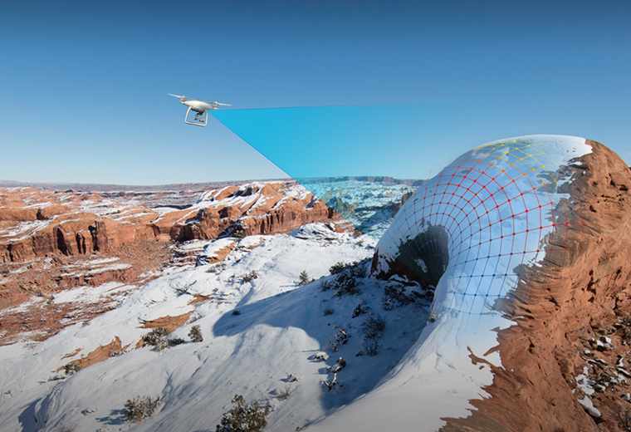
Applications
Robotics
Autonomous driving
Drones (DJI)
Creativity Art, Sport…
Notes:
近年来人工智能成功应用于线上的互联网和线下的服务机器人。
在人机交互的过程中，如何对运动目标进行高精度且实时的跟踪是服务机器人、无人机智能飞行、汽车辅助驾驶等众多应用领域的重要的研究方向。
视频跟踪是计算机视觉的一个应用核心，今年来随着无人机，服务机器人，以及辅助驾驶的应用而受到越来越多的关注热点。
视频跟踪随着嵌入式系统运算能力的大幅度提高，已经在近几年的工业系统中得到了逐渐的重视和应用。
Ninebot公司[14]也对外公布了即将发布应用于室内的服务机器人，其中人体跟踪是服务机器人的核心技术之一。
大疆公司（DJI）在2016年初发布的最新款无人机精灵4已经将跟踪系统（Active Track)融入到跟踪系统中。
在目标跟踪时，遇到了目标被视觉相似度高遮挡从而目标丢失等问题。

Slide 12
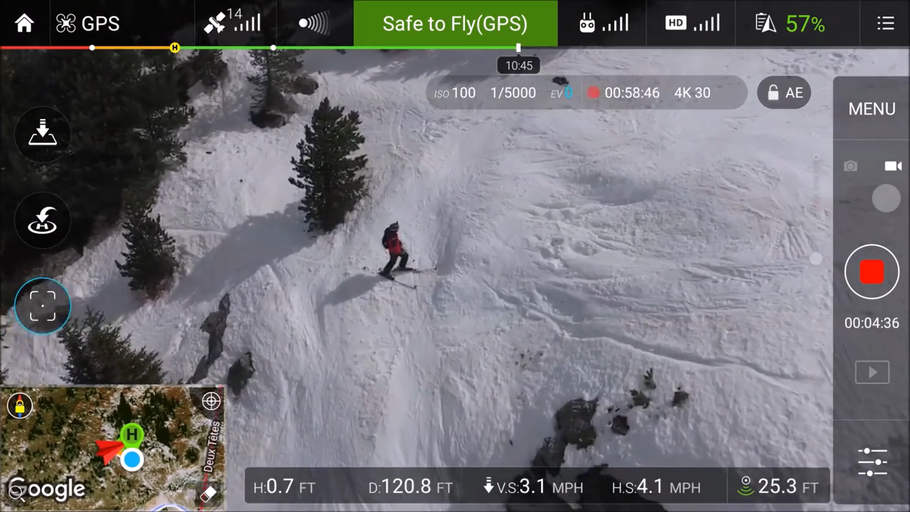

Slide 13
Challenges?
IV
Illumination Variation - the illumination in the target region is significantly changed.
Scale Variation - the ratio of the bounding boxes of the first frame and the current frame is out of the range [1/t s ,t s ], t s >1 (t s =2).
Occlusion - the target is partially or fully occluded.
Deformation - non-rigid object deformation.
Motion Blur - the target region is blurred due to the motion of target or camera.
Fast Motion - the motion of the ground truth is larger than t_m pixels (t_m =20).
In-Plane Rotation - the target rotates in the image plane.
Out-of-Plane Rotation - the target rotates out of the image plane.
Out-of-View - some portion of the target leaves the view.
Background Clutters - the background near the target has the similar color or texture as the target.
Low Resolution - the number of pixels inside the ground-truth bounding box is less than t_r (t_r =400).
SV
O'C'C
DEF
MB
FM
IPR
OPR
OV
BC
LR
Notes:
IV Illumination Variation - the illumination in the target region is significantly changed.
SV Scale Variation - the ratio of the bounding boxes of the first frame and the current frame is out of the range [1/t s ,t s ], t s >1 (t s =2).
OCC Occlusion - the target is partially or fully occluded.
DEF Deformation - non-rigid object deformation.
MB Motion Blur - the target region is blurred due to the motion of target or camera.
FM Fast Motion - the motion of the ground truth is larger than t_m pixels (t_m =20).
IPR In-Plane Rotation - the target rotates in the image plane.
OPR Out-of-Plane Rotation - the target rotates out of the image plane.
OV Out-of-View - some portion of the target leaves the view.
BC Background Clutters - the background near the target has the similar color or texture as the target.
LR Low Resolution - the number of pixels inside the ground-truth bounding box is less than t_r (t_r =400).

Slide 14
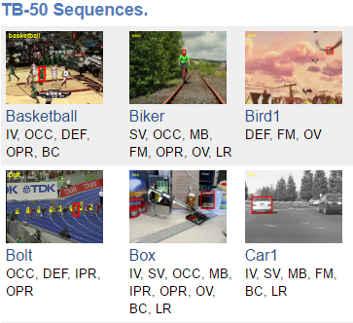

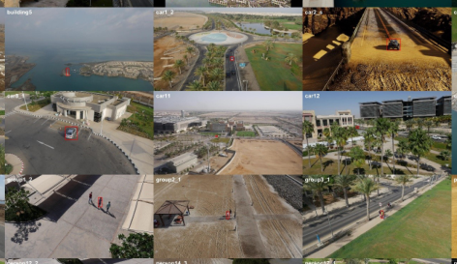
Benchmark:
Object Tracking (OBT) CVPR2013 http://cvlab.hanyang.ac.kr/tracker_benchmark/benchmark.html
Visual Object Tracking (VOT) ECCV2014, ECCV2016
http://www.votchallenge.net/
A Benchmark and Simulator for UAV Tracking, ECCV2016 https://ivul.kaust.edu.sa/Pages/pub-benchmark-simulator-uav.aspx
Notes:
图1.检测跟踪问题。标准数据库OBT中human2的跟踪序列。第一帧红色矩形框为用户输入的标定的首帧。第二到第四帧为由第一帧划定ROI需要跟踪帧的标定。目标物体在运动跟踪过程中可能有被遮挡（第二帧）等复杂情况。

Slide 15
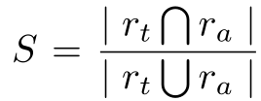
Evaluation Methodology
Precision plot： average Euclidean distance between the center locations of the tracked targets and the manually labeled ground truths. percentage of frames whose estimated location is within the given threshold distance of the ground truth.
Success plot： Given the tracked bounding box r_t and the ground truth bounding box r_a , the overlap score is defined as:

Slide 16
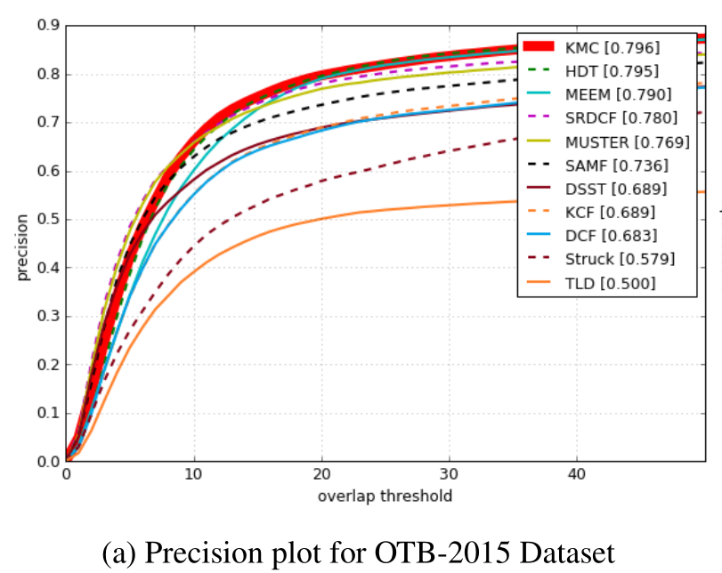
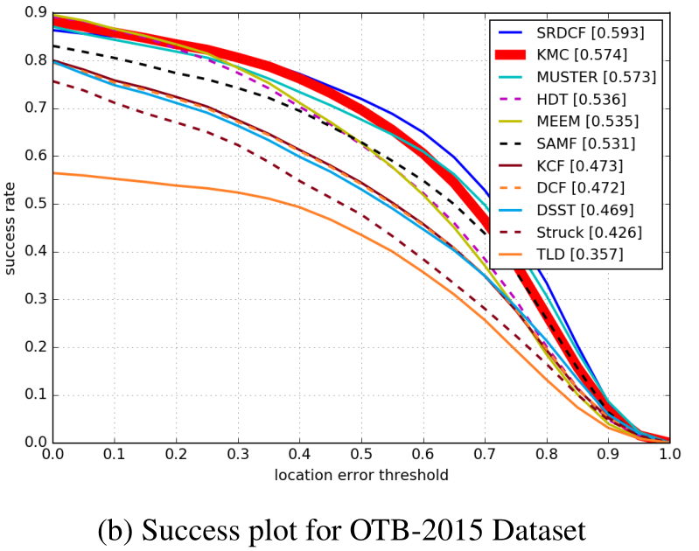
Quiz: which is which A. Left → precision plot, Right → success plot B. Left → success plot, Right → precision plot

Slide 17
High-Speed Tracking with Kernelized Correlation Filters
经典算法分析
Correlation Filter
João F. Henriques, Rui Caseiro, Pedro Martins, and Jorge Batista
tPAMI 2015

Slide 18
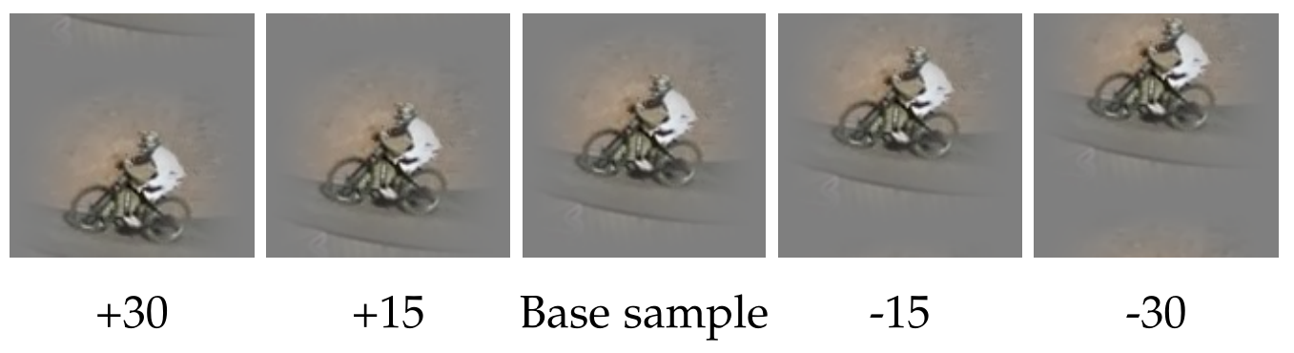
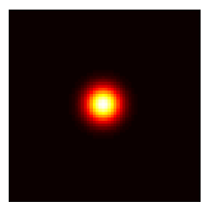
负样本
正样本
不同的位置
Notes:
Gaussian targets are smoother than binary labels, and have the benefit of reducing ringing artifacts in the Fourier domain [21].
[21] R. C. González and R. E. Woods, Digital image processing. Prentice Hall, 2008.
Modern trackers → a discriminative classifier
typically trained with translated and scaled sample patches
riddled with redundancies
Above observation →
resulting data matrix is circulant: diagonalise it with Discrete Fourier Transform (DFT), reducing both storage and computation by several orders of magnitude
Kernalized Correlation Filter (KCF)
outperform top-ranking trackers such as Struck or TLD,
running at hundreds frames-per-second
being implemented in a few lines of code.
open-source

Slide 19
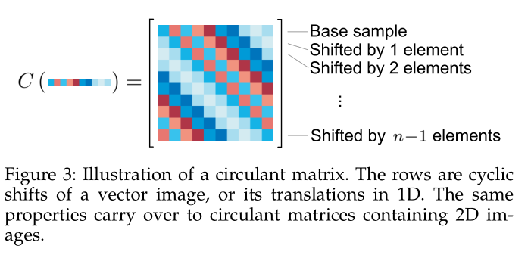
Building Block 1: Circulant Matrix

Slide 20
Quiz 1:
Write down the circulant matrix C for X:
where X = [255, 254, 253, 252, 251] C =
255 | 254 | 253 | 252 | 251

Slide 21
Quiz 2:
For 2 dimensional data X, if X is M*N, what’s the dimension of C?
A. M+N
B. M^(N) +N^(N)
C. 2*M*N
D. None of the above

Slide 22
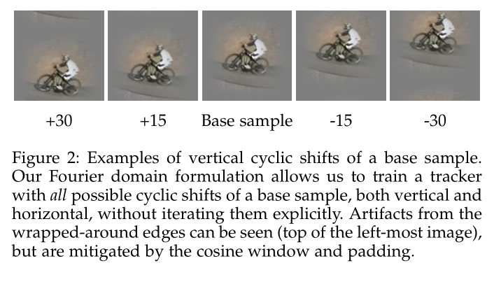
all circulant matrices are made diagonal by the Discrete Fourier Transform (DFT), regardless of the generating vector
X = F diag (x) F^H
Notes:
What is perhaps most amazing and useful is the fact that all circulant matrices are made diagonal by the Discrete
Fourier Transform (DFT), regardless of the generating vector
x [34]. This can be expressed as
X = F diag (ˆ x) F H

Slide 23
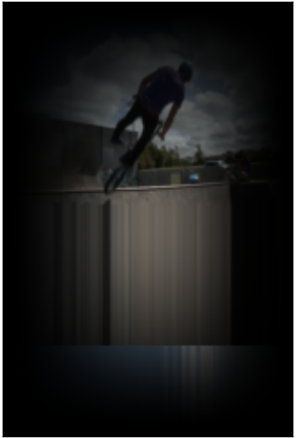
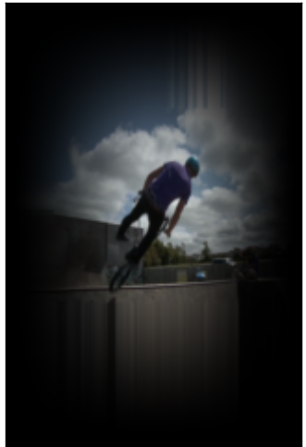
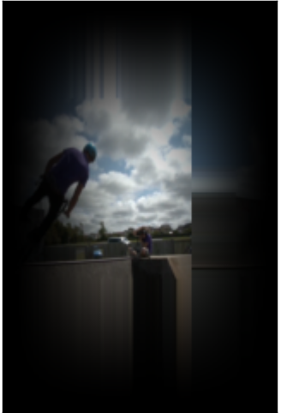
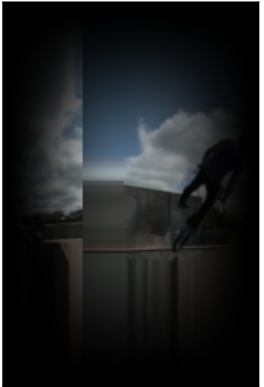
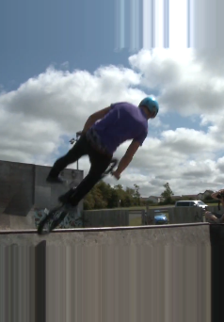
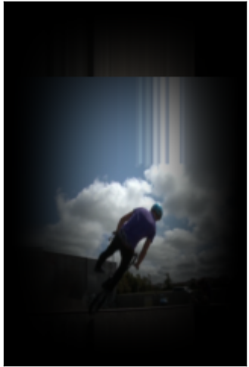
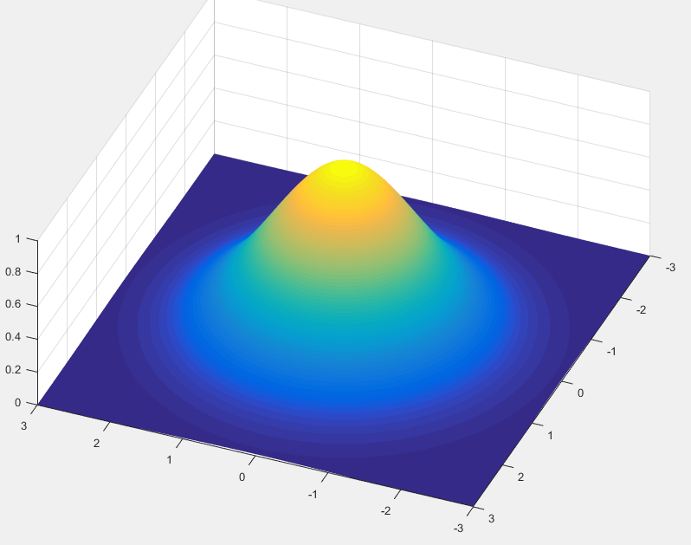
Understanding the circulant matrix
1.0
0.5
0.5
0.5
0.5

Slide 24
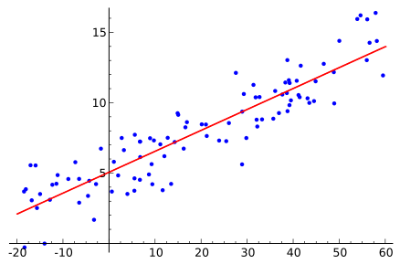
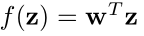
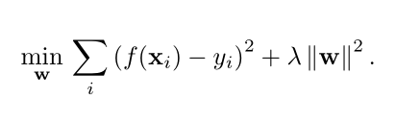
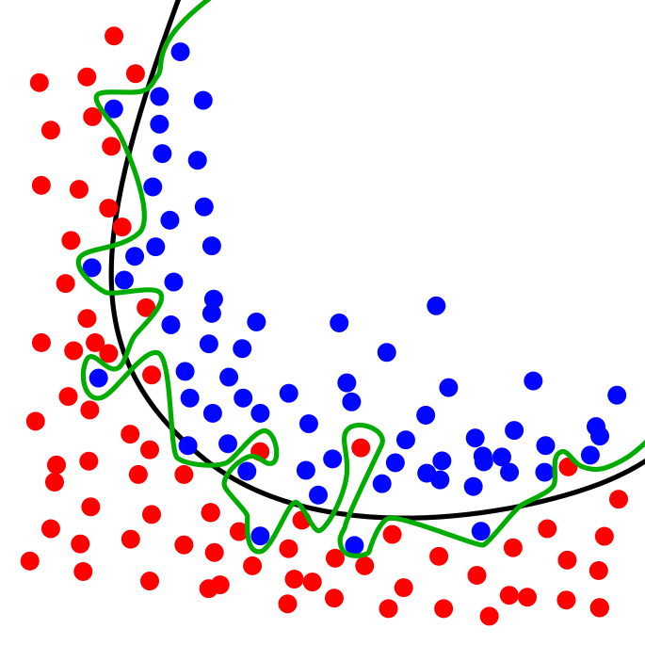
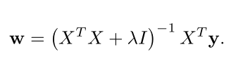
Building block 2: Linear regression
Notes:
The goal of training is to find a function f(z) = w T z that minimizes the squared error over samples x_i and their regression targets y_i ,

Slide 25
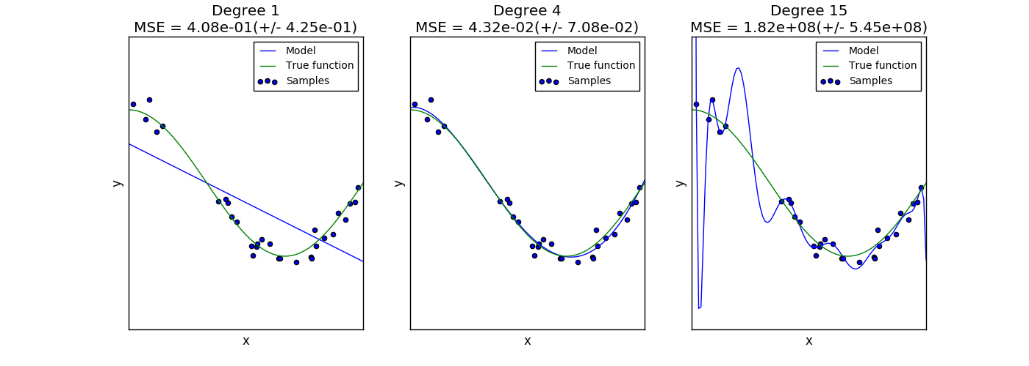
Quiz: Overfitting & Underfitting→

Slide 26
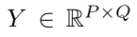
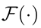
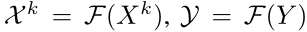
Putting it all together
feature map extracted from the k-th feature maps
gaussian shape label matrix
discrete Fourier transformation (DFT)
Notes:
X: denotes the feature map extracted from the k-th convolutional layer;
Y: denotes a gaussian shape label matrix, which is subject to a 2D Gaussian distribution with zero mean and standard deviation proportional to the target size;

Slide 27
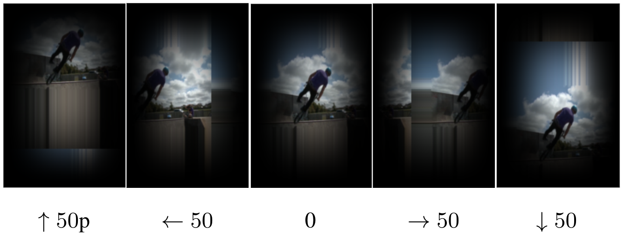
TAKE A LOOK AGAIN?
The attentive reader will notice that the last element wraps around, inducing some distortion relative to a true translation. However, this undesirable property can be mitigated by appropriate padding and windowing .
The fact that a large percentage of the elements of a signal are still modelled correctly, even for relatively large translations (see Fig. 2), explains the observation that cyclic shifts work well in practice.

Slide 28

经典算法分析 Kernelized Correlation Filters
+ 150 fps

Slide 29
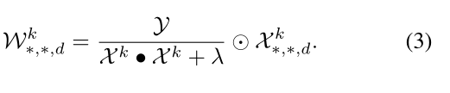
A little add-on: why FFT?
“…compared to the prevalent method of extracting patches explicitly and solving a general regression problem. For example, Ridge Regression has a cost of O(n³), bound by the matrix inversion and products.
On the other hand, all operations .. are element-wise (O(n)), except for the DFT, which bounds the cost at a nearly-linear O(nlogn). For typical data sizes, this reduces storage and computation by several orders of magnitude.
High-Speed Tracking with Kernelized Correlation Filters, João F. Henriques, Rui Caseiro, Pedro Martins, and Jorge Batista, tPAMI 2015

Slide 30
DEMO

Slide 31
Challenges?
IV
Illumination Variation - the illumination in the target region is significantly changed.
Scale Variation - the ratio of the bounding boxes of the first frame and the current frame is out of the range [1/t s ,t s ], t s >1 (t s =2).
Occlusion - the target is partially or fully occluded.
Deformation - non-rigid object deformation.
Motion Blur - the target region is blurred due to the motion of target or camera.
Fast Motion - the motion of the ground truth is larger than t_m pixels (t_m =20).
In-Plane Rotation - the target rotates in the image plane.
Out-of-Plane Rotation - the target rotates out of the image plane.
Out-of-View - some portion of the target leaves the view.
Background Clutters - the background near the target has the similar color or texture as the target.
Low Resolution - the number of pixels inside the ground-truth bounding box is less than t_r (t_r =400).
SV
O'C'C
DEF
MB
FM
IPR
OPR
OV
BC
LR
Notes:
IV Illumination Variation - the illumination in the target region is significantly changed.
SV Scale Variation - the ratio of the bounding boxes of the first frame and the current frame is out of the range [1/t s ,t s ], t s >1 (t s =2).
OCC Occlusion - the target is partially or fully occluded.
DEF Deformation - non-rigid object deformation.
MB Motion Blur - the target region is blurred due to the motion of target or camera.
FM Fast Motion - the motion of the ground truth is larger than t_m pixels (t_m =20).
IPR In-Plane Rotation - the target rotates in the image plane.
OPR Out-of-Plane Rotation - the target rotates out of the image plane.
OV Out-of-View - some portion of the target leaves the view.
BC Background Clutters - the background near the target has the similar color or texture as the target.
LR Low Resolution - the number of pixels inside the ground-truth bounding box is less than t_r (t_r =400).

Slide 32
Research Directions
HOG →very similar to SIFT
[1] Krizhevsky, Alex, Ilya Sutskever, and Geoffrey E. Hinton. “Imagenet classification with deep convolutional neural networks.” （NIPS）. 2012.
[2] A. Graves, M. Liwicki, S. Fernandez, R. Bertolami, H. Bunke, J. Schmidhuber. A Novel Connectionist System for Improved Unconstrained Handwriting Recognition。 tPAMI, 2009
[3] Di Wu, Lionel Pigou, Pieter-Jan Kindermans, Nam Le, Ling Shao, Joni Dambre, and Jean-Marc Odobez “Deep Dynamic Neural Networks for Multimodal Gesture Segmentation and Recognition. tPAMI 2016

Slide 33

多种神经网络：
时序神经网络的引入
Visualizing and Understanding Recurrent Networks,
Andrej Karpathy, Justin Johnson, Li Fei-fei ICLR2016 workshop
Notes:
Sequences. Depending on your background you might be wondering: What makes Recurrent Networks so special
Each rectangle is a vector and arrows represent functions (e.g. matrix multiply). Input vectors are in red, output vectors are in blue and green vectors hold the RNN's state (more on this soon). From left to right: (1) Vanilla mode of processing without RNN, from fixed-sized input to fixed-sized output (e.g. image classification). (2) Sequence output (e.g. image captioning takes an image and outputs a sentence of words). (3) Sequence input (e.g. sentiment analysis where a given sentence is classified as expressing positive or negative sentiment). (4) Sequence input and sequence output (e.g. Machine Translation: an RNN reads a sentence in English and then outputs a sentence in French). (5) Synced sequence input and output (e.g. video classification where we wish to label each frame of the video). Notice that in every case are no pre-specified constraints on the lengths sequences because the recurrent transformation (green) is fixed and can be applied as many times as we like.
A glaring limitation of Vanilla Neural Networks (and also Convolutional Networks) is that their API is too constrained: they accept a fixed-sized vector as input (e.g. an image) and produce a fixed-sized vector as output (e.g. probabilities of different classes). Not only that: These models perform this mapping using a fixed amount of computational steps (e.g. the number of layers in the model). The core reason that recurrent nets are more exciting is that they allow us to operate over sequences of vectors: Sequences in the input, the output, or in the most general case both.

Slide 34
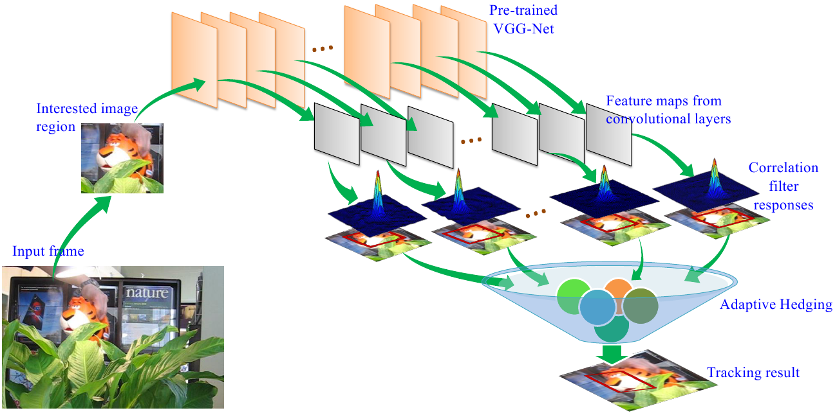
Convolutional Neural Networks（CNN）
[1] L. Wang, W. Ouyang, X. Wang, and H. Lu. “STCT: Sequentially training convolutional networks for visual tracking” . CVPR,2016.
[2] Qi, Yuankai, et al. "Hedged Deep Tracking." CVPR. 2016.
[3] Hua, Yang, KarteekAlahari, and Cordelia Schmid. "Online object tracking with proposal selection." ICCV 2015.
[4] Wang, Lijun, et al. "Visual tracking with fully convolutional networks.“ ICCV. 2015.
…
Qi, Yuankai, et al. "Hedged Deep Tracking." CVPR. 2016.
[2] Qi, Yuankai, et al. "Hedged Deep Tracking." CVPR. 2016.
Notes:
2015年和2016年分别获得ImageNet图像识别竞赛冠军的VGGNet和ResNet能够为单帧的图像提供图像的阶级特征，在有图像处理芯片(GPU)的支持下能够达到每秒钟处理50张以上的图片。
existing method: CNN last layer → represent target objects
deeper layers capture rich category-level semantic information, useful for object classification, NOT optimal for visual tracking.
earlier layers: more generic
To achieve better tracking performance: combine features from different layers

Slide 35

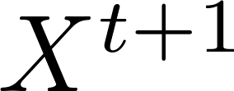
Recurrent Neural Networks (RNN)
…
x^{t}
y^{t}
w^{t}
h^{t}
x^{t+1}
y^{t+1}
w^{t+1}
h^{t+1}
…
RNN
RNN
CNN
CNN
Notes:
项目采用深度学习的框架，神经的网络框架在预学习（pretraining）和自学习的框架下展开。针对每个视频帧，首先利用卷积神经网络生成特征阶级向量，然后用时序神经网络完成跟踪目标时序的模拟，最终形成端到端的训练测试模型。
循环神经网络在视频运动目标的跟踪系统框架，其中 为t时间点的输入帧（图一种的单幅图像）。图像经过卷积神经网络（CNN）提取出图像各阶层的特征后输入到循环神经网络（RNN）进行对ROI的回归。其中输出层和隐层的特征将作为下一帧的输入。训练的时候，图像帧的长度选择将视频帧根据图像处理芯片(GPU)的内存大小，模拟时序潜在运动规律（如速度，加速度等隐含信息）所需的帧数等综合信息考虑，将长度固定的帧组成批量(minibatch),然后将其输入到RNN网络中进行对ROI的回归。

Slide 36
Assignment
Use webcam to take of a video of yourself.
Face detection + tracking pipeline for the video stream and upload 3 consecutive frames. And name them as “your_name.py”
Create a subfolder and name the subfolder under AI_Precourse\Week5_Tracking\You_Name, put the 3 frames into your name subfolder.
Push the new change to your “origin” repo and create a pull request so that you change will be seen by the “upstream”

